Slide 1
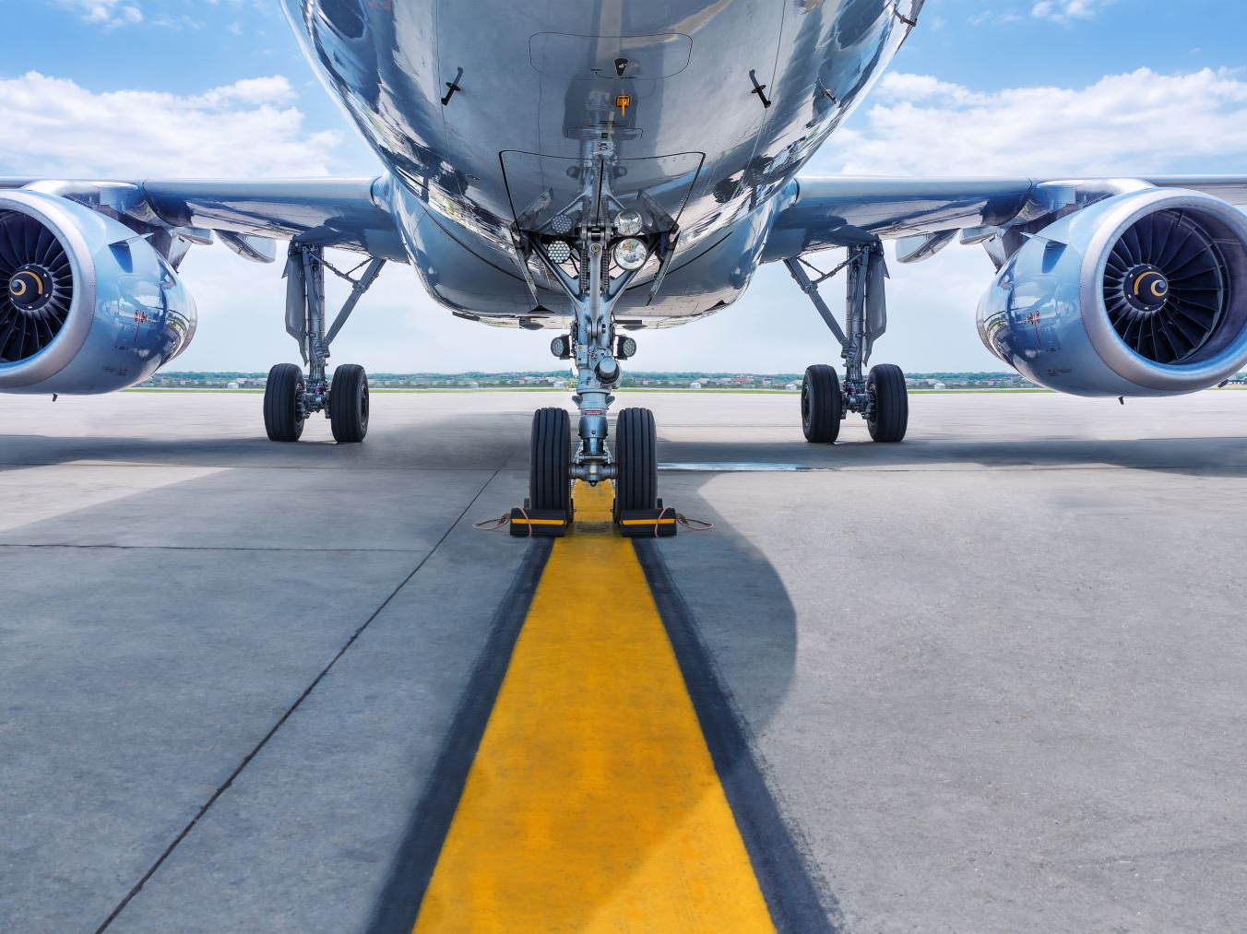
Aircraft Predictive Maintenance
By
Athanti, Suresh

Slide 2
Contents
1. Types of Maintenance
2. What is Predictive maintenance ?
3. Problem statement
4. Solution approach
5. Dataset discussion
6. Machine learning algorithms
7. Results

Slide 3
Maintenance Types
Reactive Maintenance
Preventive Maintenance
Predictive Maintenance

Slide 4
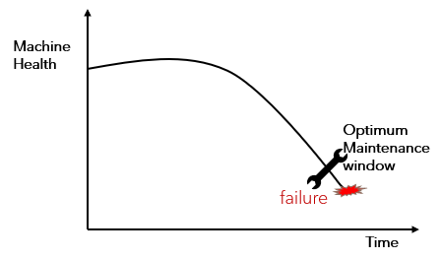
What is Predictive maintenance ?
Predictive maintenance techniques are designed to help determine the condition of in-service equipment in order to estimate when maintenance should be performed.
Pros:
1. Increased life cycle of a machine
2. Reduced downtime of an Equipment / Engine
3. Cost Saving
Cons:
1. Requires Monitoring Equipment
2. Requires Skillful Data Interpretation

Slide 5
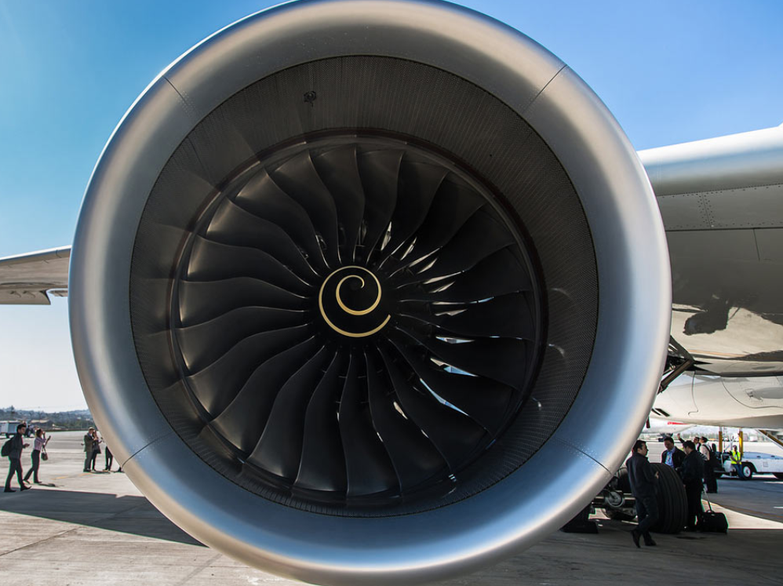
Problem Statement
The remaining useful life (RUL) of a machine is the expected life or usage time remaining before the machine requires repair or replacement. Most of the airline industries are interested in predicting the engine failures in the in advance to reduce the operational costs and down time of an aircraft.
By observing the engine’s health condition from the sensor values time to failure of an in-service equipment can be predicted.
Using the time-series data of the sensor measurements machine learning algorithm can be trained which can predict the remaining useful life (RUL) of the aircraft engine.

Slide 6
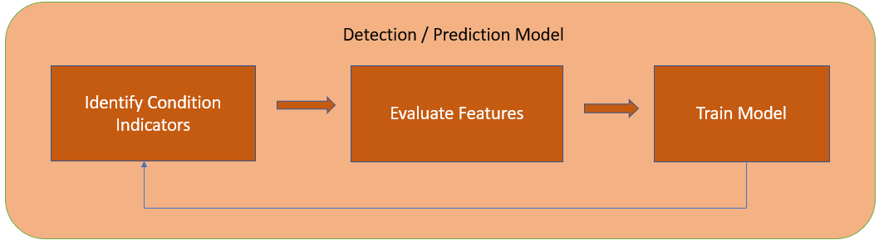
Solution Approach
→ Machine learning algorithm can learn the relationships between the sensor values and changes in sensor values to the historical failures in order to predict the failures in the future.
The solution can be obtained by following modelling approaches:
1. Regression: Predicting the Remaining Useful Life (RUL)
2. Classification: Predict if an engine will fail in certain time frame.
3. Multiclass-Classification: Predict if an engine will fail in different time windows.
→ Our focus is on the Regression task which is used to predict the remaining useful component life

Slide 7
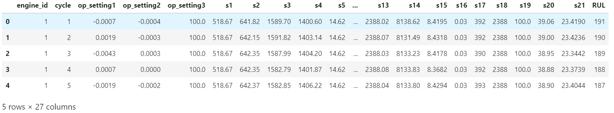
Dataset
The dataset contains the run to failure events, operational conditions and sensor values of engines. Different engines sets were simulated under different combinations of operational conditions and fault modes. Records several sensor channels to characterize fault evolution.
Training dataset & Test Dataset:

Slide 8
Data Description
This dataset contains the information about 100 run-to-failure engines. Feature description is as follows:
1) unit number (1-100) 2) time, in cycles 3) operational settings (1…3) 4) sensor measurements (S1….S21)
Test Dataset also contains the same information, and the labels are same for test data.
Exploratory data analysis is done and relationship between the variables is found out.

Slide 9
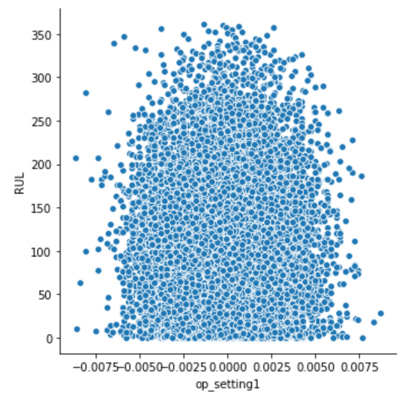
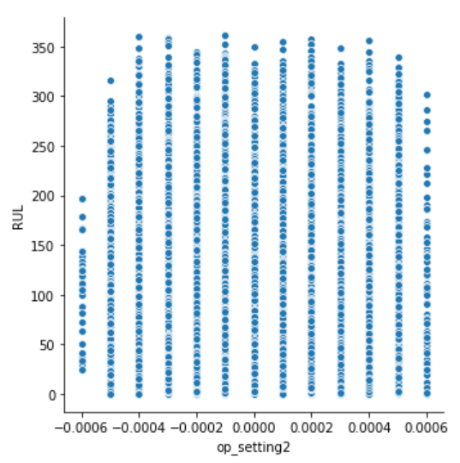
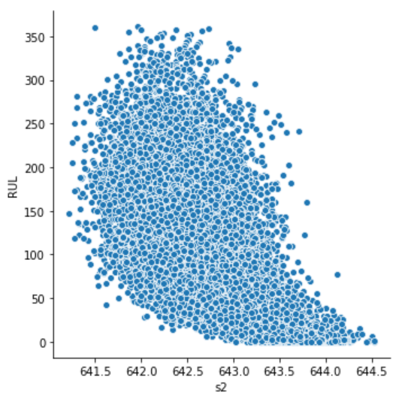
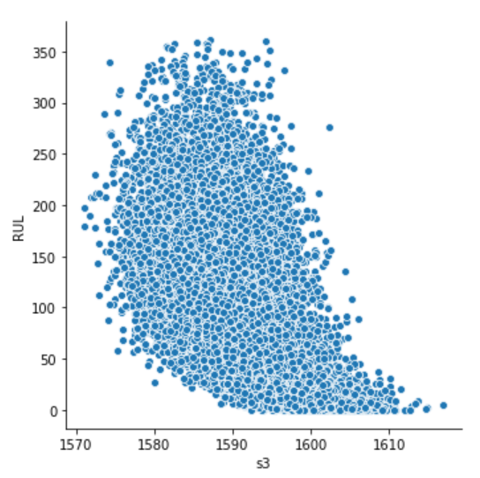
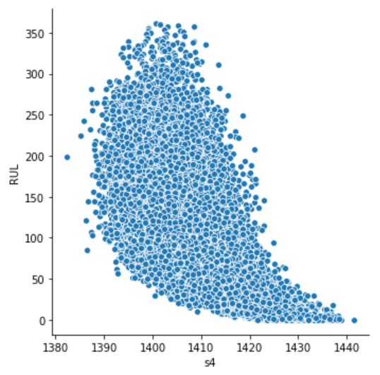
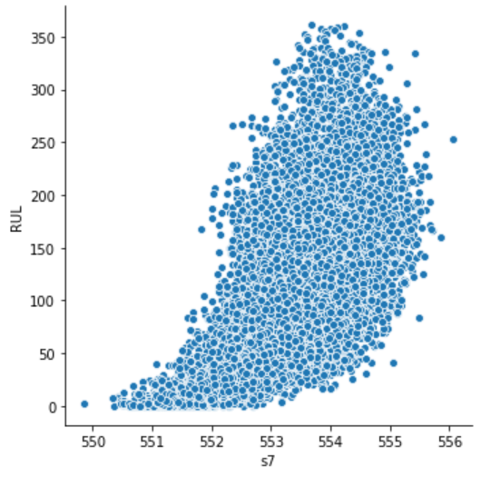
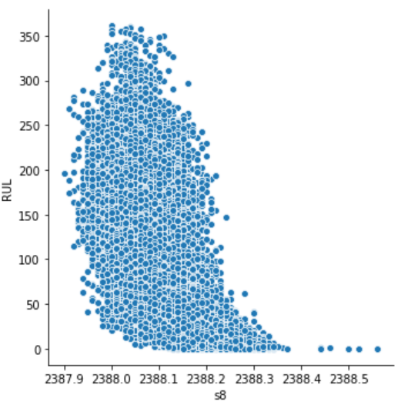
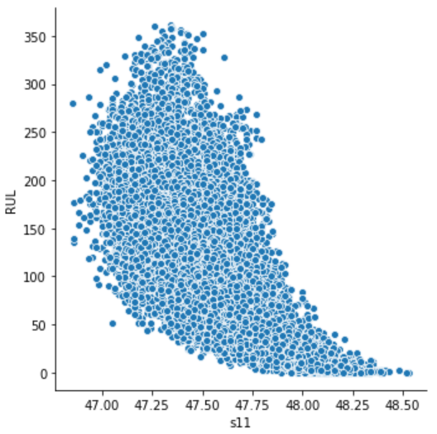
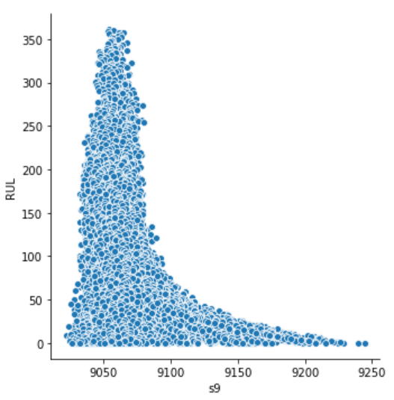
Data Distribution

Slide 10
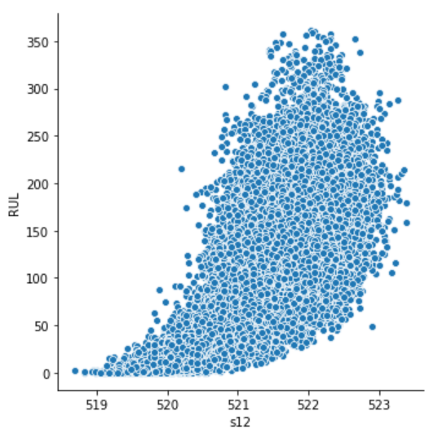
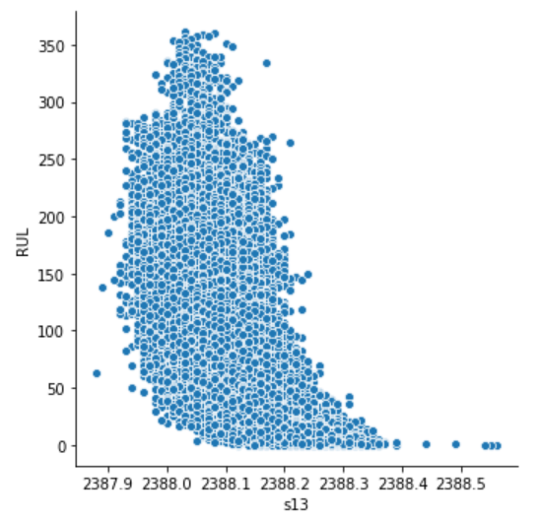
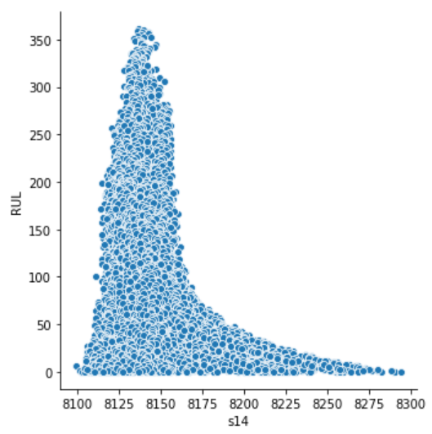
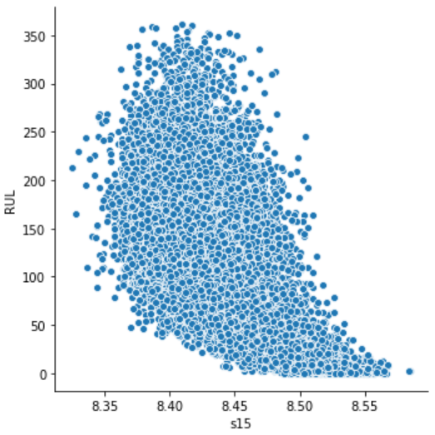
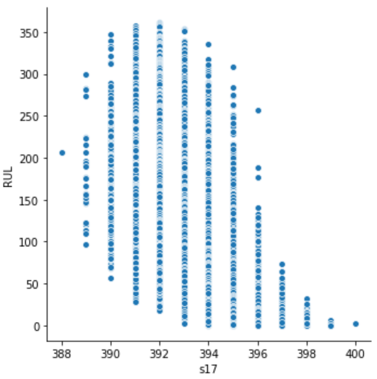
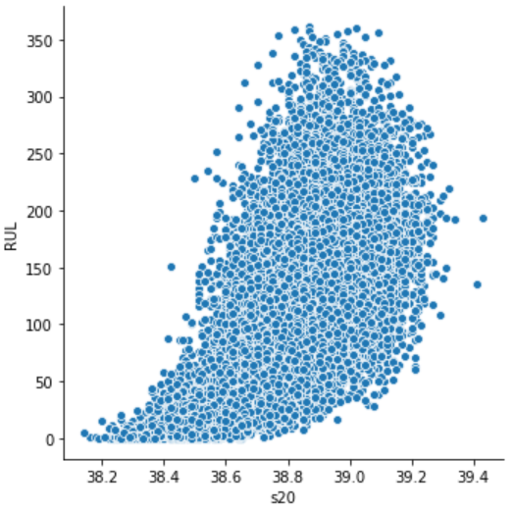
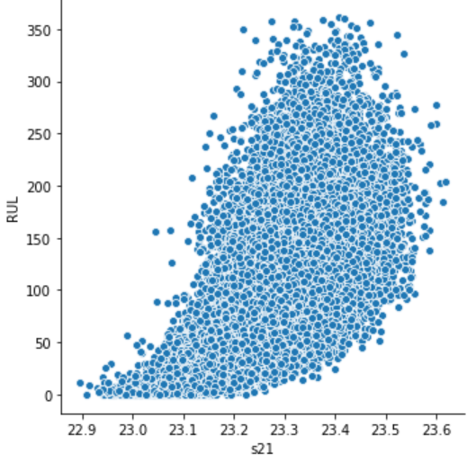
Data Distribution

Slide 11
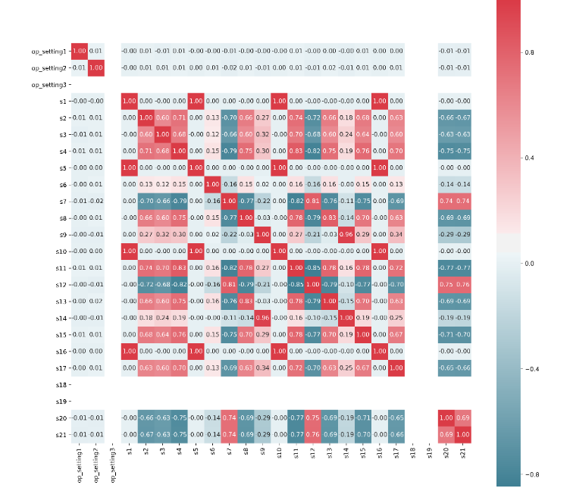
EDA: Correlation plot
From the correlation plot between the variables, we could see some features which are constant with time are not having any correlation or they are not considered. features - op_setting3, S1, S10, S16, S18, S19, S5, S6.

Slide 12
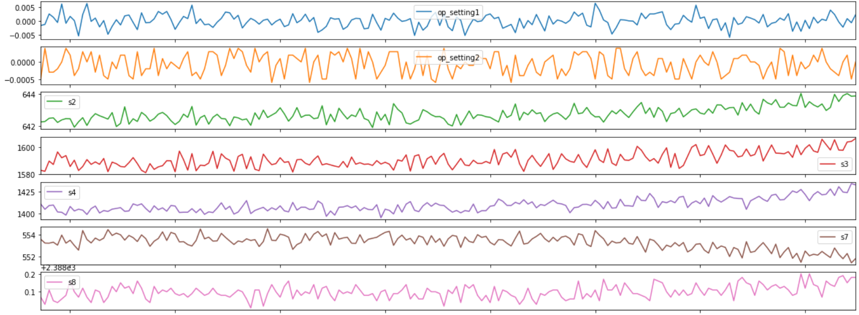
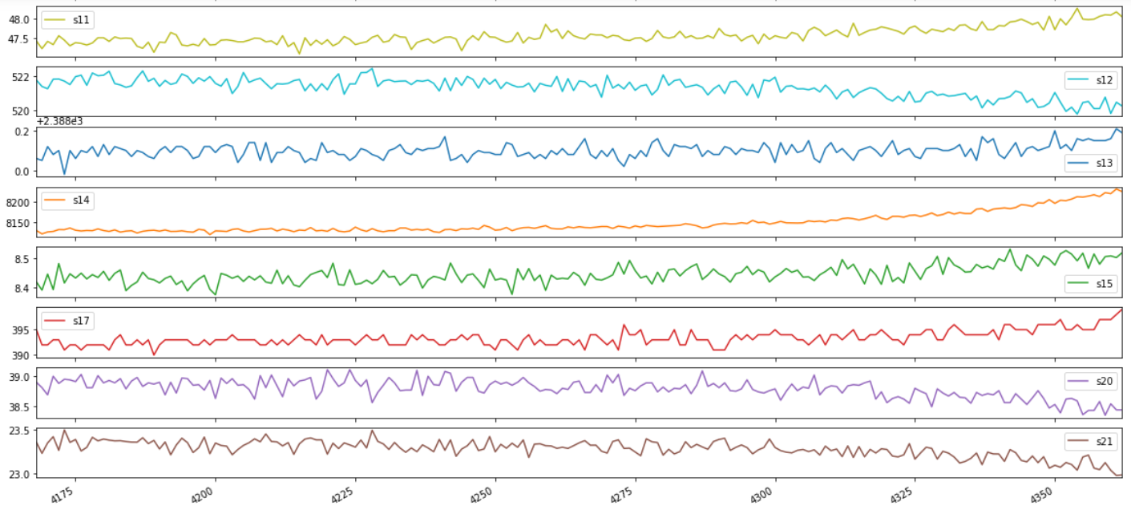
Engine 21 Visualizations

Slide 13
Machine Learning
Task:
Regression:- To predict Remaining Useful Life of an engine before its failure.
Algorithms used:
1. Linear Regression
2. Polynomial Regression
3. Decision Tree Regression
4. Lasso Regression
5. Random forest Regression
6. LGBM Regression
7. XGB Regression
8. Cat Boost Regressor

Slide 14
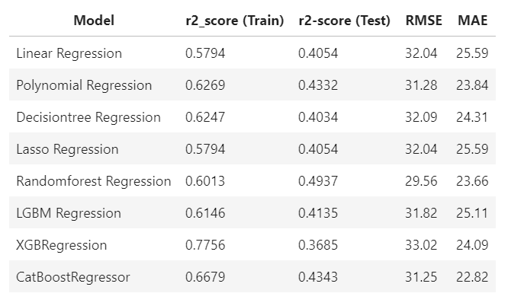
Model Evaluation
Regression Model evaluation and their metrics:

Slide 15
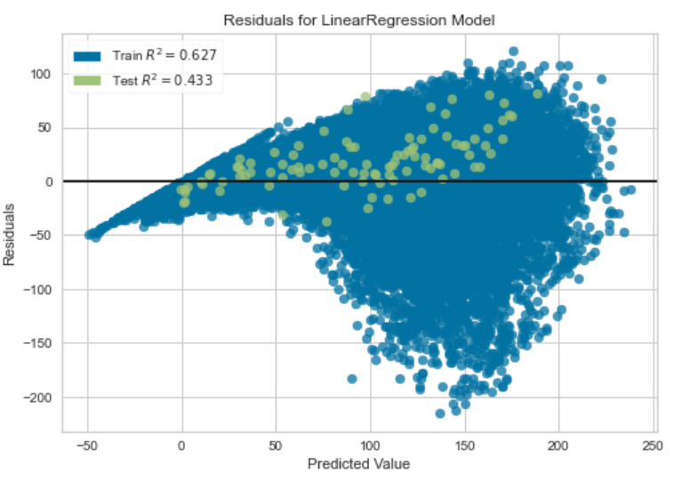
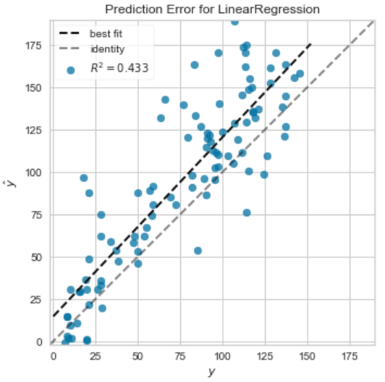
Model Visualizations
Polynomial model Visualizations

Slide 16
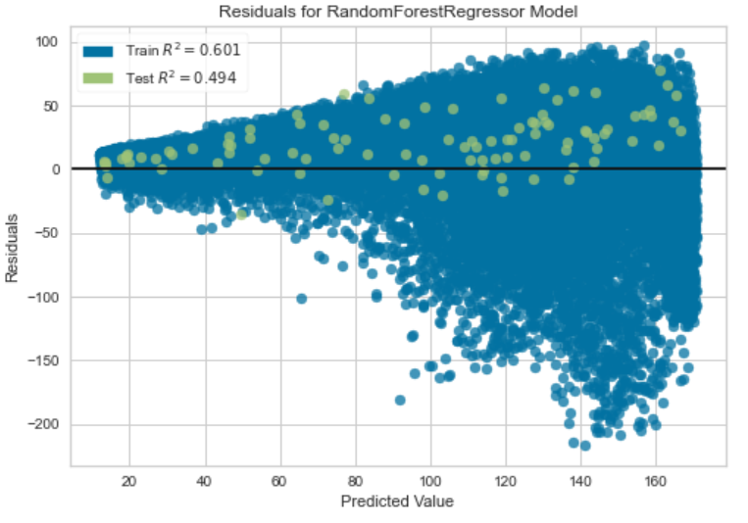
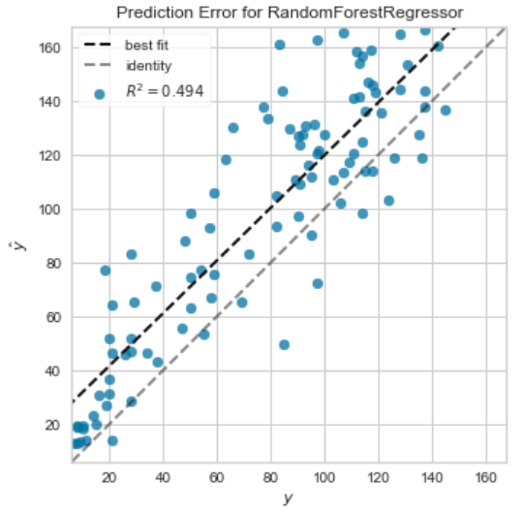
Model Visualizations
Random Forest Visualizations

Slide 17
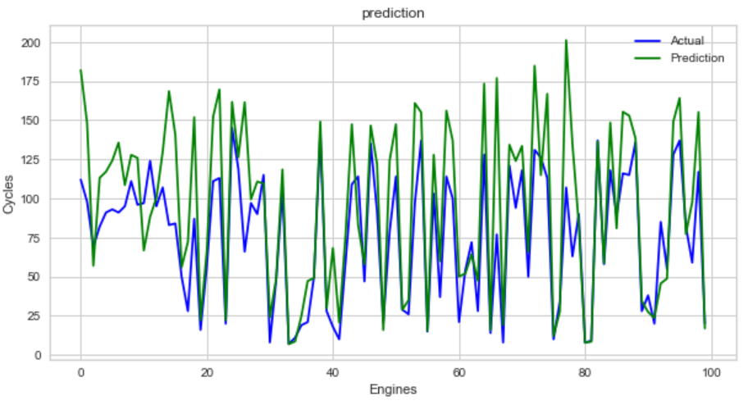
Predictions
Actual vs Prediction Visualizations

Slide 18
Conclusion
Most of the data is non- linear with the target variable. So non-linear models performed better then linear models.
Random Forest Regression model performs slightly better then other models with ±29.56 cycles.
The Remaining Useful Life of certain parts with limited life before it’s failure can be predicted by extending this approach for other parts.
As continuation, Neural Network Models can be used to predict RUL based on input sensor measurements with larger datasets.

Slide 19

Thank you.

